Slide 1

ARULMIGU PALANIANDAVAR COLLEGE OF ARTS AND CULTURE
DEPARTMENT OF MATHEMATICS
Course name: Data literacy with tableau
Project name: Indian’s crop production analysis (1997-2021)
Submitted by:
R. METHA PRABHA
A .MALAVIKA
K.VINOTHA
K. ASIK MOGAIDEEN
Mentor:
K. Maruthamuthu

Slide 2
INTRODUCTION OF TABLEAU
Tableau Desktop is a “ Data visualization “ application to facilitate you to examine virtually and kind of structure data and generate highly interactive, beautiful graphs, dashboards, and reports within minutes.
Once a quick installation, you can tie to virtually any data source from spreadsheets to data warehouses and display information in several graphic perspectives.
Designed to be easy to utilize, you’ll be working more rapidly than ever before.

Slide 3
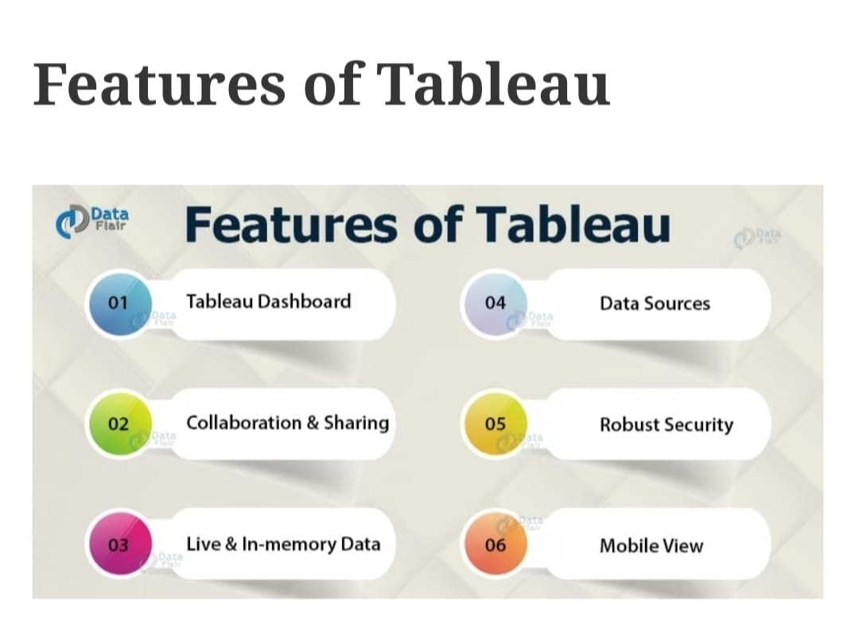

Slide 4
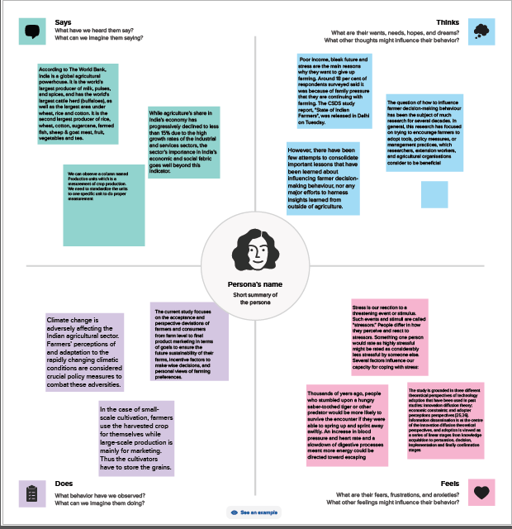
EMPTHY MAP

Slide 5
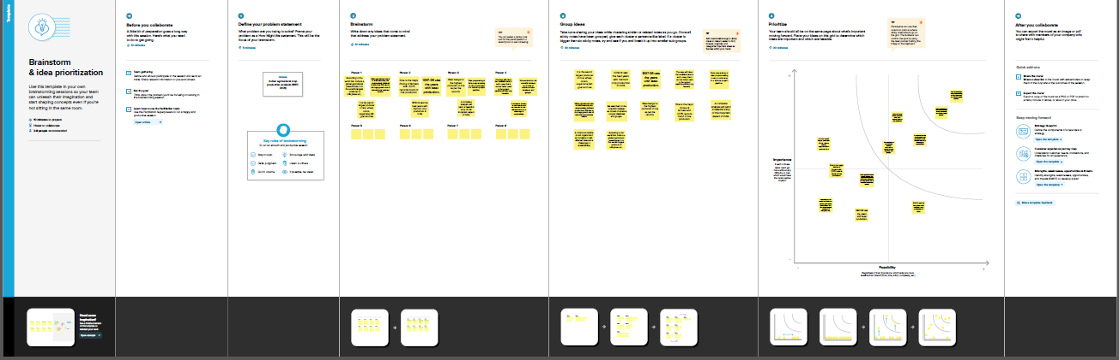
BRAINSTROMING MAP

Slide 6
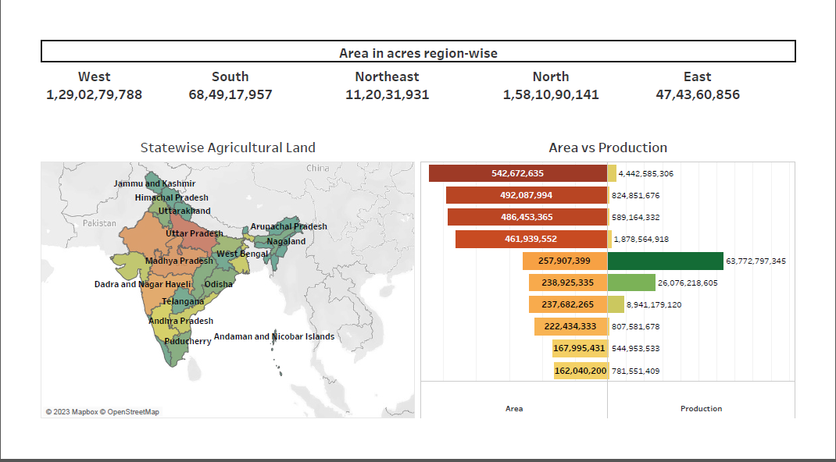
Indian agriculture crop production dashboard 1

Slide 7
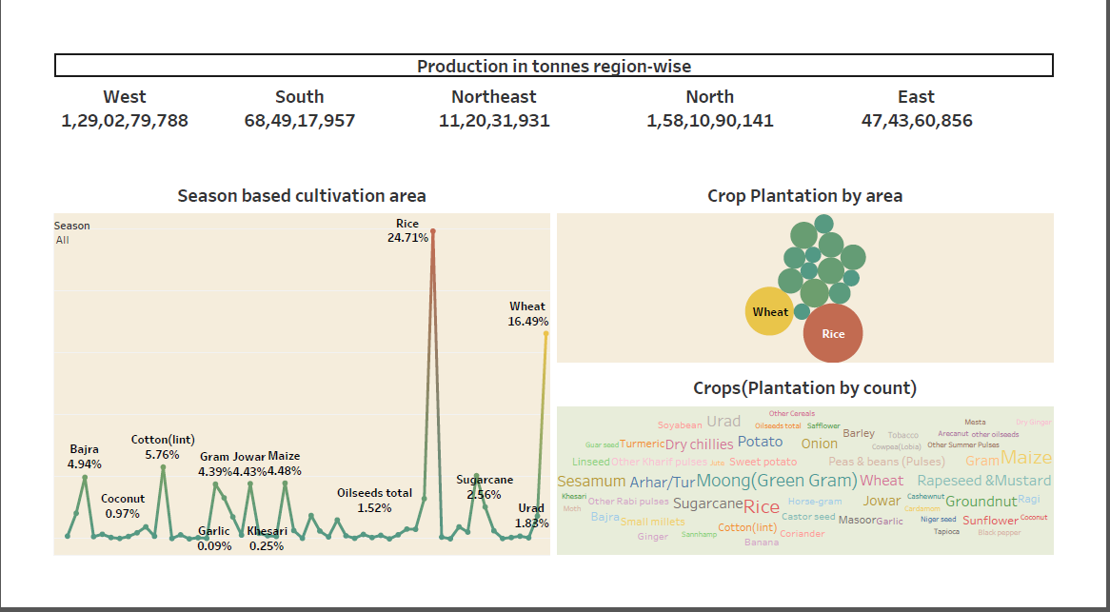
Indian agriculture crop production dashboard 2

Slide 8
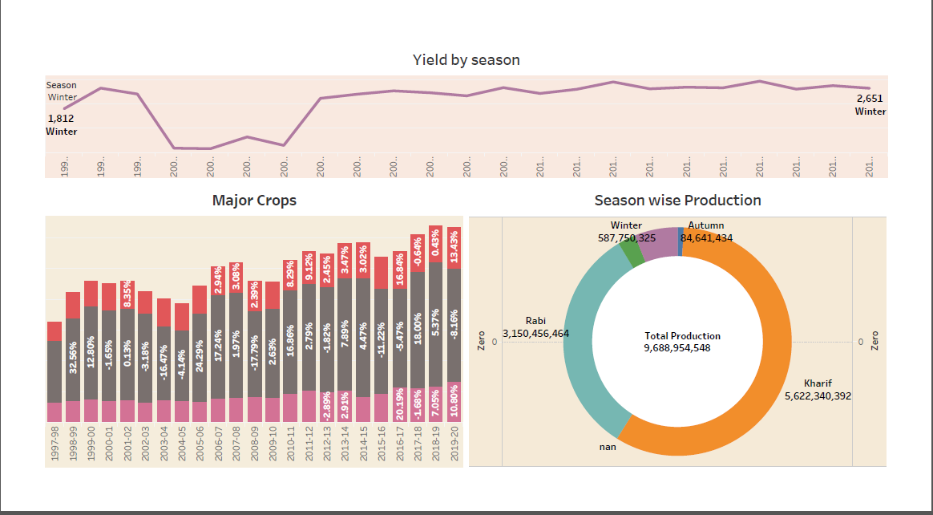
Indian agriculture crop production dashboard 3

Slide 9
DATA SET

Slide 10
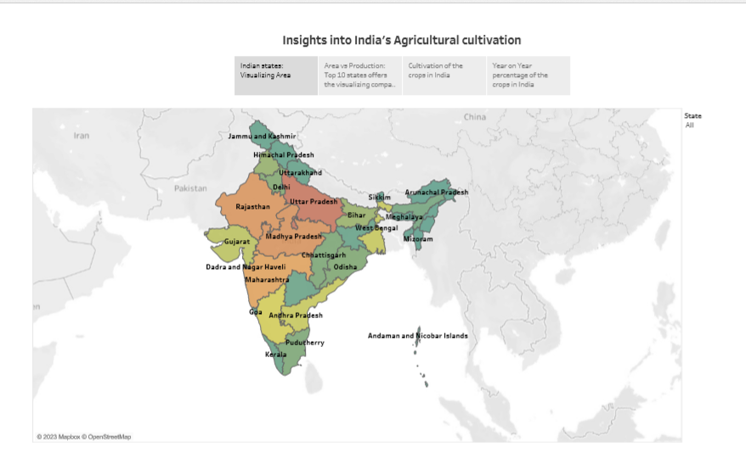
STORY

Slide 11
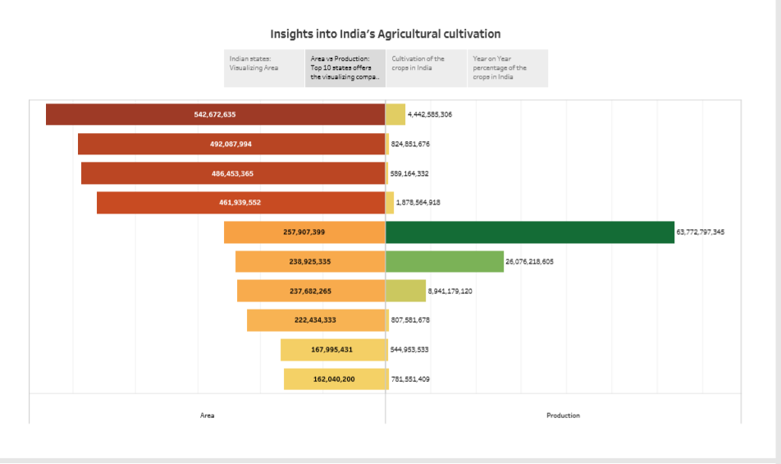

Slide 12
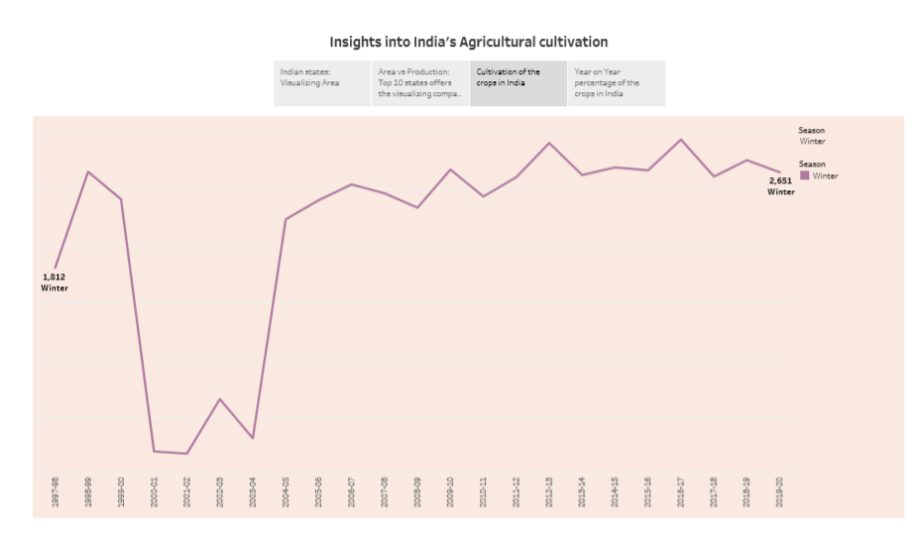

Slide 13
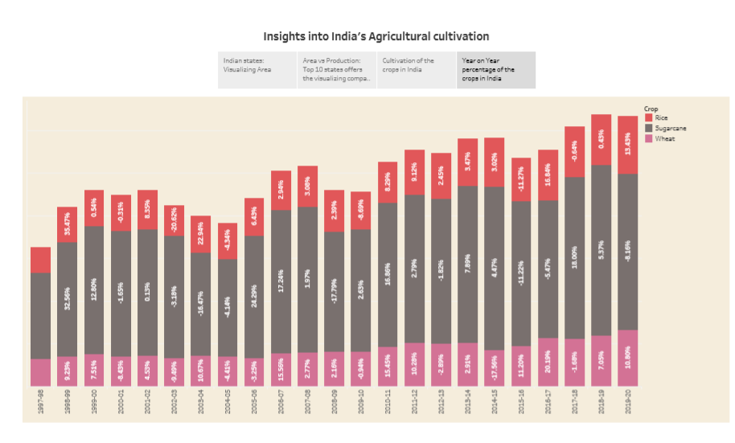

Slide 14
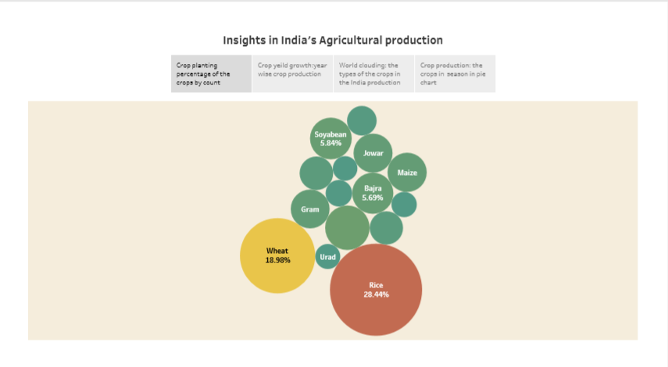

Slide 15
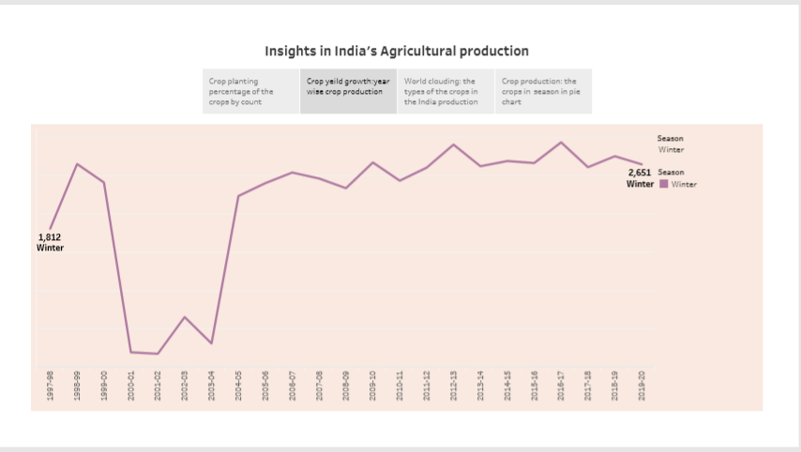

Slide 16
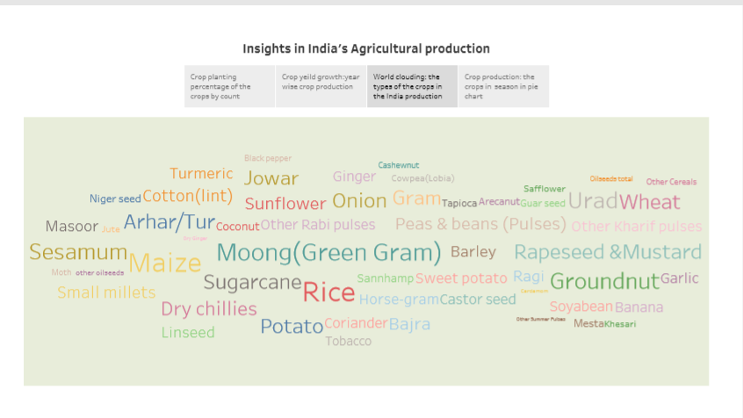

Slide 17
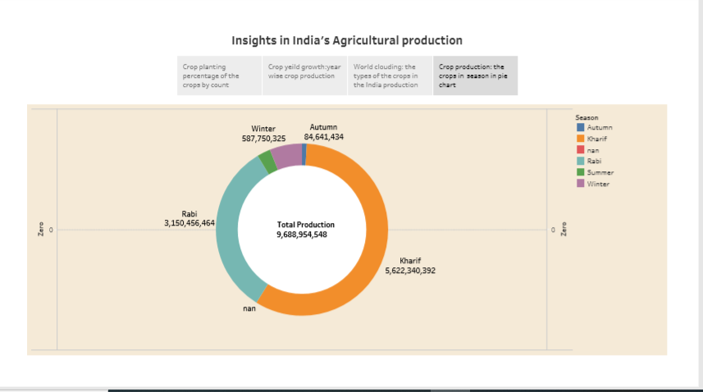

Slide 18
Tableau public link
https://public.tableau.com/app/profile/metha.prabha.r/viz/IndiasagriculturalcropproductionStory-2/indianagridashboard1?publish=yes
https://public.tableau.com/app/profile/metha.prabha.r/viz/IndiasagriculturalcropproductionStory-2/indianagridashboard2?publish=yes
https://public.tableau.com/app/profile/metha.prabha.r/viz/Indiasagriculturalcropproductiondashboard3_16965896621690/indianagridashboard3?publish=yes
https://public.tableau.com/app/profile/metha.prabha.r/viz/Indiasagriculturalcropproductionstory1_16965897905000/indianagristory1?publish=yes
https://public.tableau.com/app/profile/metha.prabha.r/viz/Indiasagriculturalcropproductionstory2_16965899073940/indianagristory2?publish=yes

Slide 19
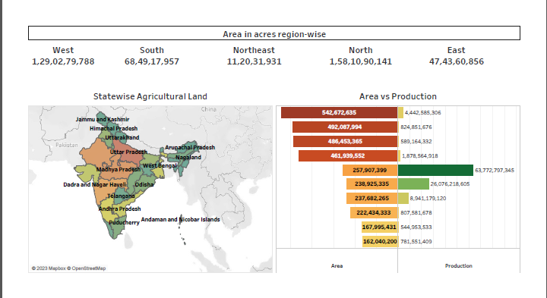
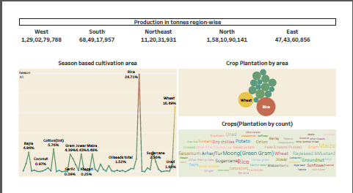

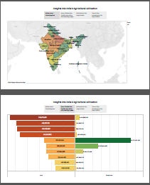
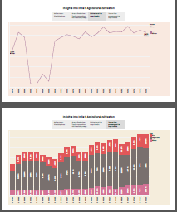
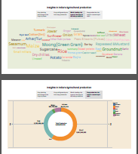
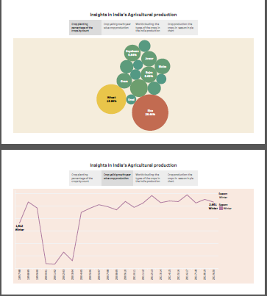
SHREENSHOTS OF DASHBOARD AND STORY

Slide 20
CONCLUSION
Tableau is an excellent program to simplify all your data visualization activities and provide better and more accurate analysis if you’ve even tried data visualisation and found it tough to grasp or too complex.

Slide 21
THANKYOU

